Slide 1



DR.BABASAHEB AMBEDKAR TECHNOLOGICAL UNIVERSITY (DIPLOMA WING)
DEPARTMENT OF INFORMATION TECHNOLOGY
Project On
IOPE DIARIES
Guided By :-Prof. Aniket Shelake
Presented By :-
SEJAL RAVINDRA PAWAR(2201967)
MANISH SHASHIKANT JADHAV(2201933)
SHRUTI SAJAY GURAV(2201929)

Slide 2

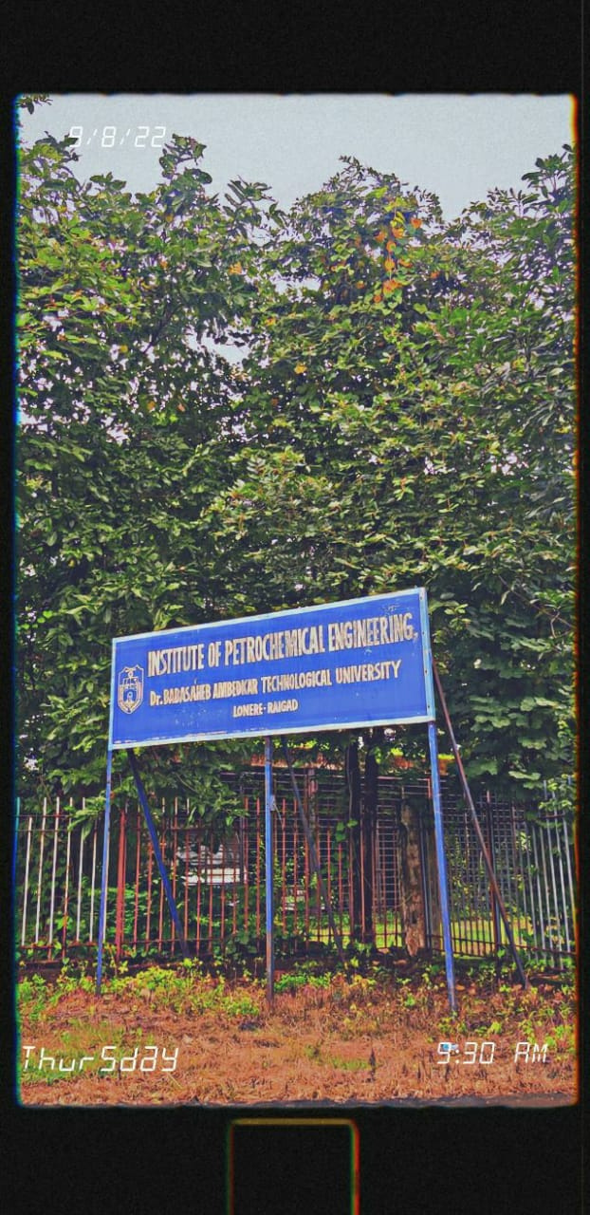
INTRODUCTION
Our project "IOPE Diaries" introduces a user-friendly platform that seamlessly connects event administrators and attendees. With a simple and intuitive interface, the solution allows administrators to upload event details and associated images, making them easily accessible to the entire college community. Users can explore the vast array of events and access comprehensive information with just a few clicks.

Slide 3


PROBLEM STATEMENT
Designing an effective college event website that caters to the needs of both students and faculty, while ensuring seamless navigation and optimal user experience, is a challenging task. The website must provide comprehensive information about conducted events, relevant details, and should also incorporate features that promote engagement, networking, and community building. The challenge lies in balancing functionality, aesthetics, and usability, while adhering to time and budget constraints.

Slide 4

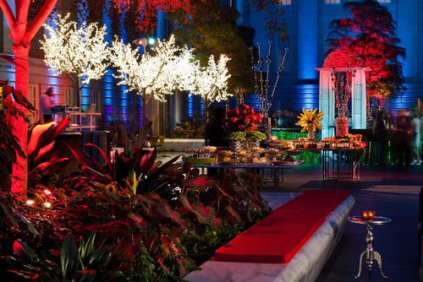
OBJECTIVES
Easy-to-use
Usability
Ease of accessingthe platform.
User Friendly Interface.

Slide 5
OBJECTIVES
Gain
Promote Campus Culture
Confidence to participate in other events.
A objective for a college event website could be to promote campus culture and showcase the diversity of events and activities happening on campus. By highlighting events from a variety of departments and student groups, the website can help create a more vibrant and inclusive campus community.

Slide 6
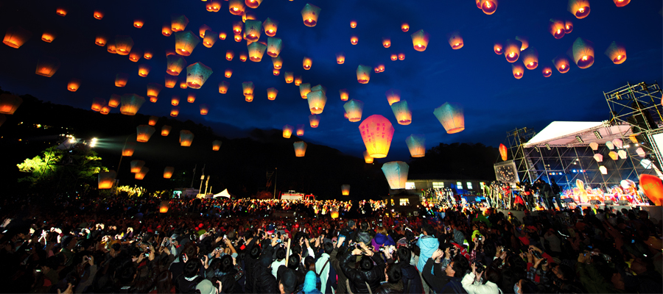
IMPLEMENTATION
Admin has access to upload events.
Allow admin to upload relevant images for each event.
User-friendly layout for easy navigation
User has access to explore and view events.
User can select an event for more information.
Display details such as date,department in which event was conducted, description.
Showcase a gallery of images related to the event.

Slide 7

HOMEPAGE

Slide 8
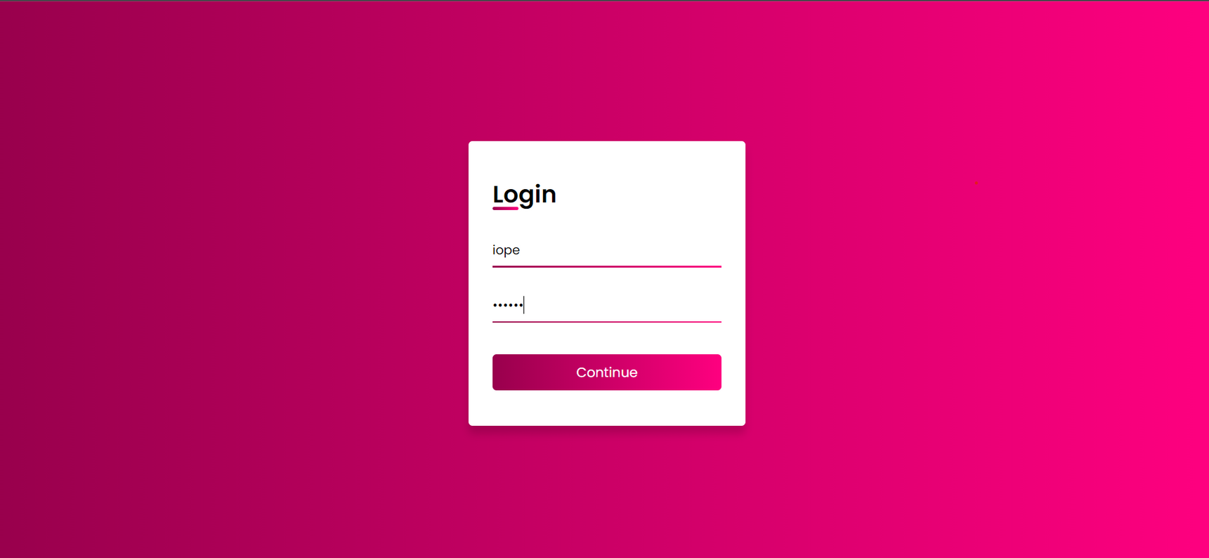
LOGIN PAGE

Slide 9
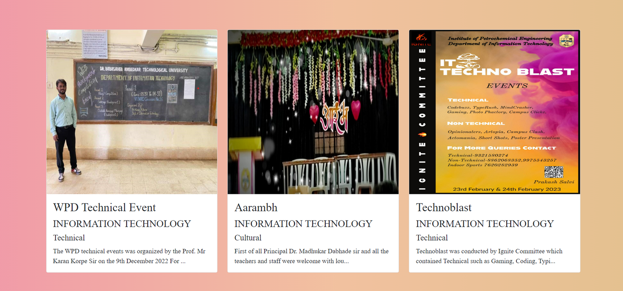
EVENT SECTION

Slide 10
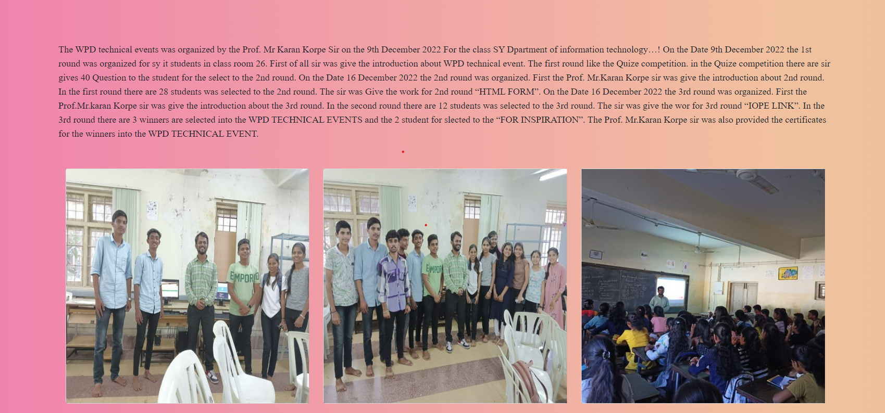
IMAGE SECTION OF EVENTS

Slide 11

Software and Hardware Requirements
IDE: VS Code IDE.
Framework: Bootstrap.
Operating System: Windows 8 above.
RAM 2GB minimum, 4GB recommended.
Hard Disk: 128GB.

Slide 12

IOPE DIARIES
ADVANATGES
DISADVANTAGES
Convinient to manage and organize multiple events.
Users can effortlessly browse through the events conducted in the college.
Provides a centralized platform for managing and organizing all the college events
The project saves time and reduces paperwork, making it a cost-effective solution for the college.
There can be a possibility of technical glitches or server issues.
If users do not have access to an internet connection, they may not be able to view event descriptions and images.

Slide 13


CONCLUSION
In conclusion, the event project showcases a seamless platform where college administrators can upload events and event images, which are then displayed in the user event section. Users can easily access event details by clicking on the desired event, viewing the event description and images. This efficient system enhances communication and engagement between administrators and users, facilitating a more interactive and enjoyable experience for all participants.

Slide 14

THANK YOU

